Slide 1
Procure to Pay cycle
Sayan Mukherjee

Slide 2
Procure to Pay steps
Create Requisition
Requisition sent for approval
Requisition approved
Create Purchase order
Purchase order sent for approval
PO approved
Goods received and matched
Invoice generated
Pay the required amount
Payment generated sucessfully

Slide 3
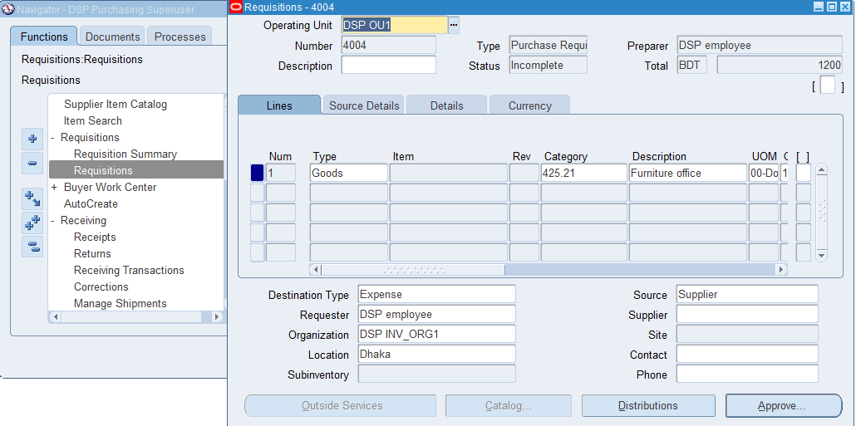
Create Requisition
Notes:
Navigation: Requisition -> Requisitions

Slide 4
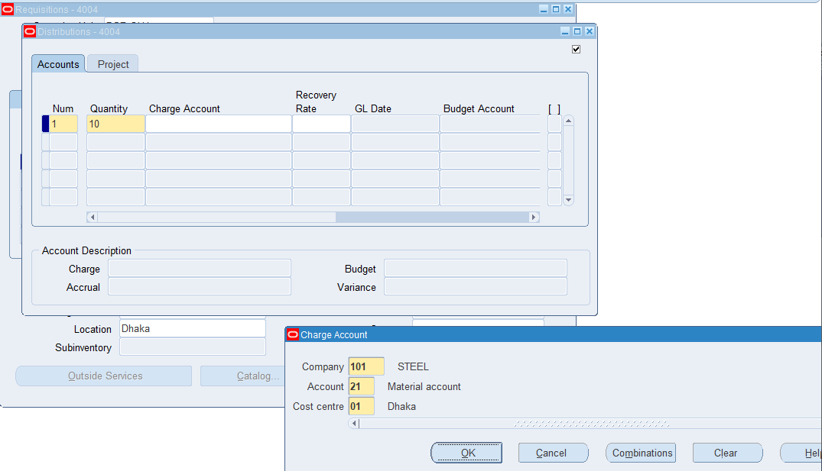
Create Requisition
Assign charge account for distribution amount

Slide 5
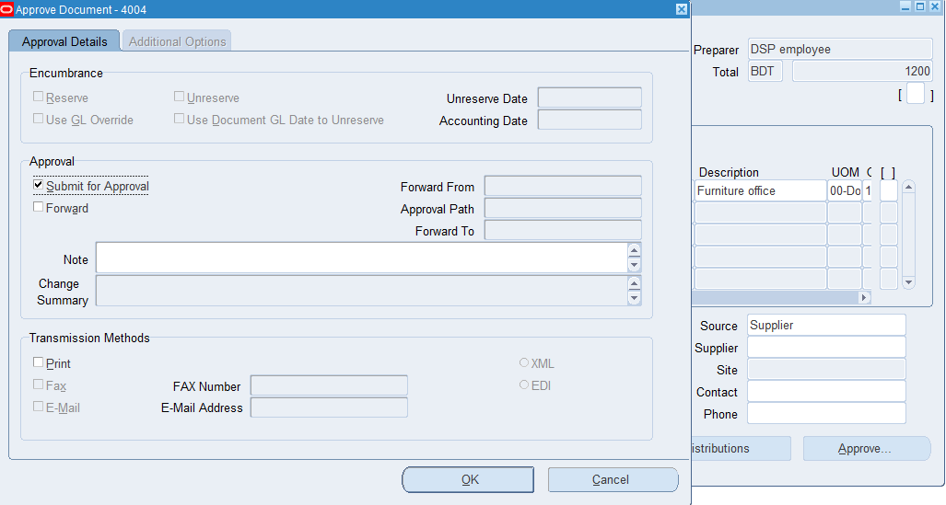
Create Requisition
Requisition sent for approval

Slide 6
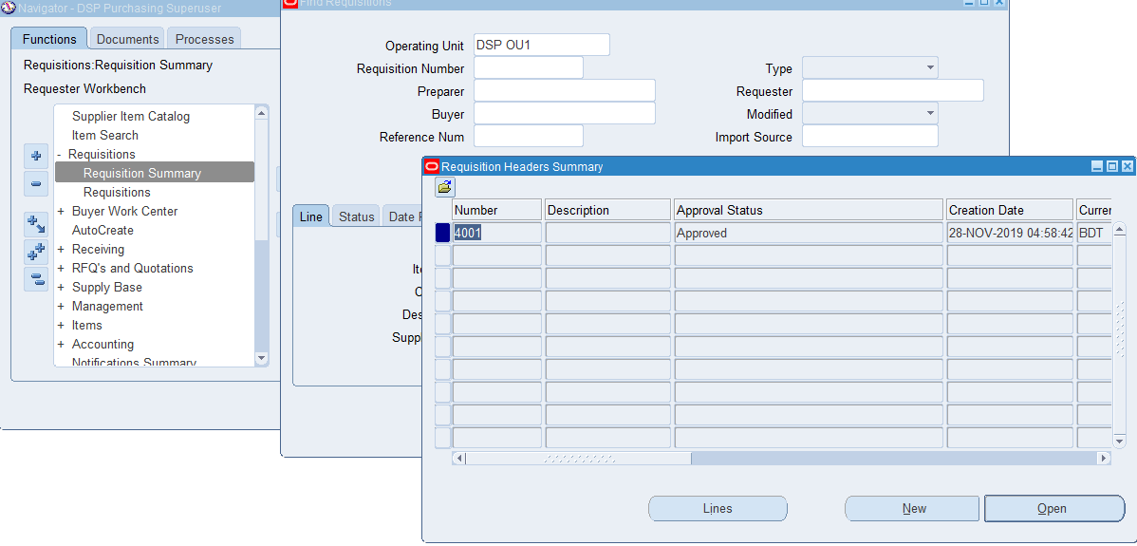
Requisition Approved

Slide 7
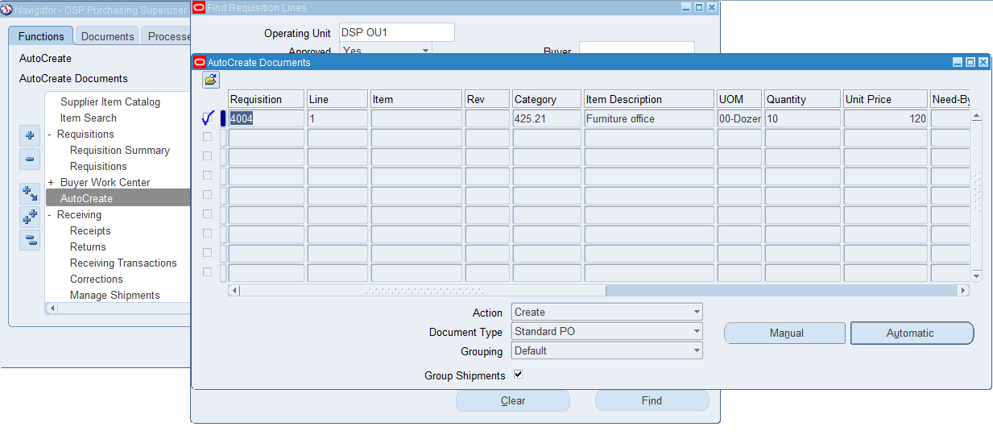
Create PO

Slide 8
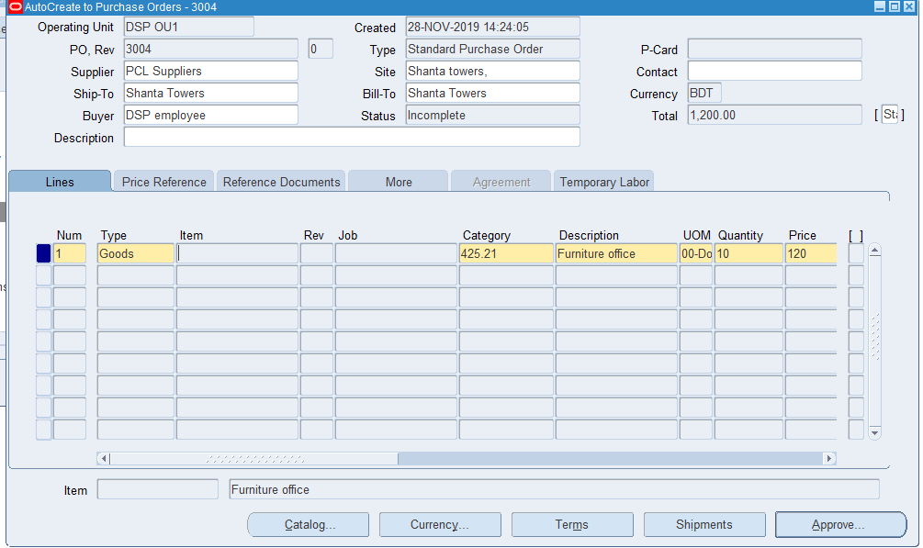
Create PO
Enter required details like Type, Category, Description, Qty, Price Ship to, bill to location,
Supplier name

Slide 9
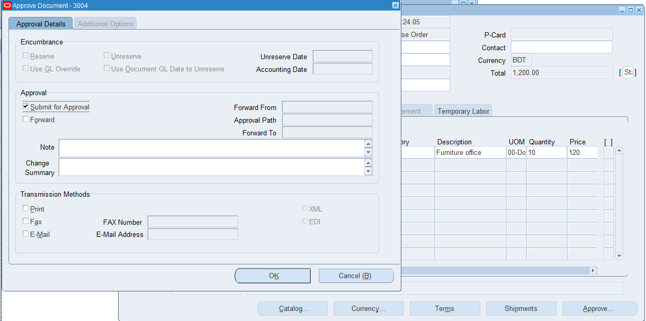
Sent PO for Approval

Slide 10
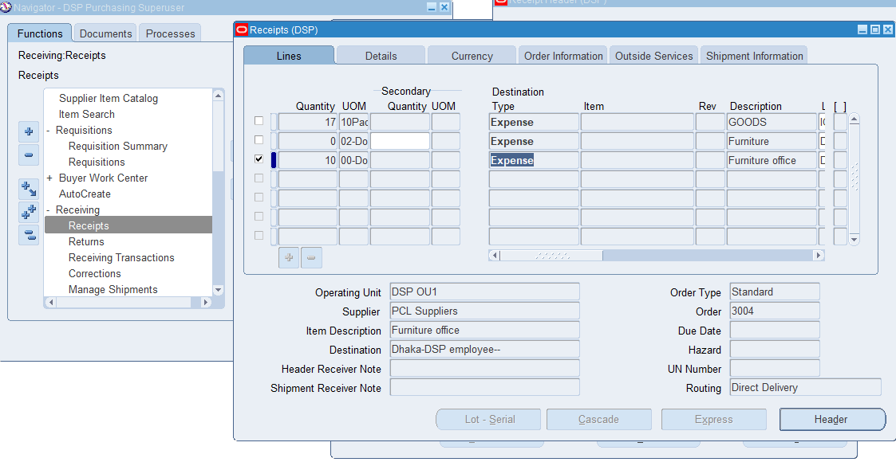
Receipt of goods

Slide 11
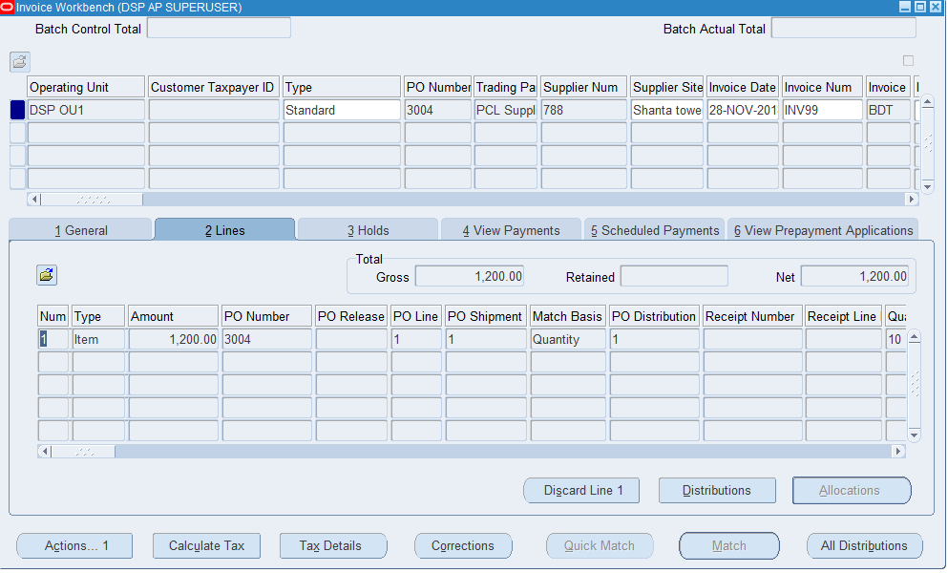
Generate Invoice

Slide 12
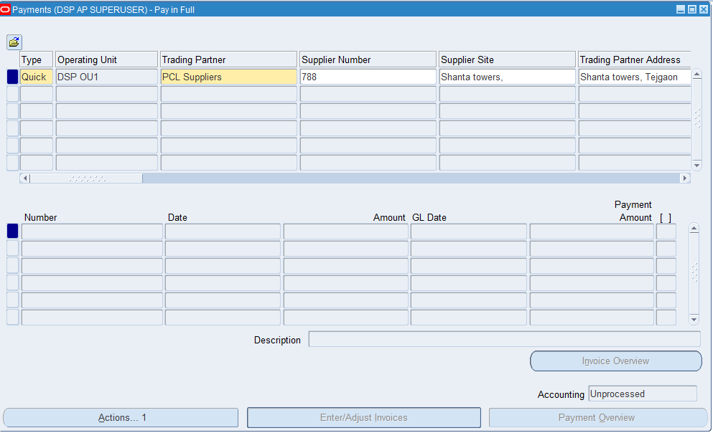
Click to add payment related detail

Slide 13
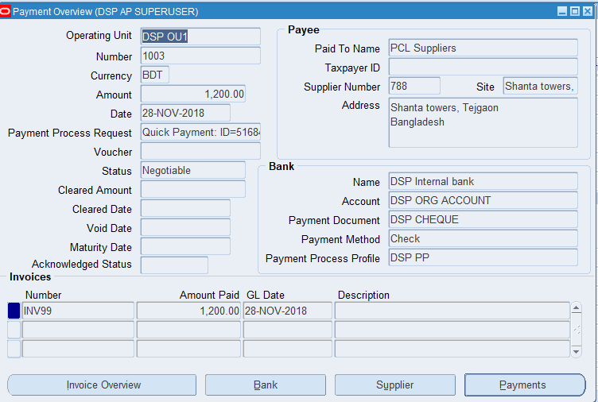
Payment generated successfully

